Slide 1
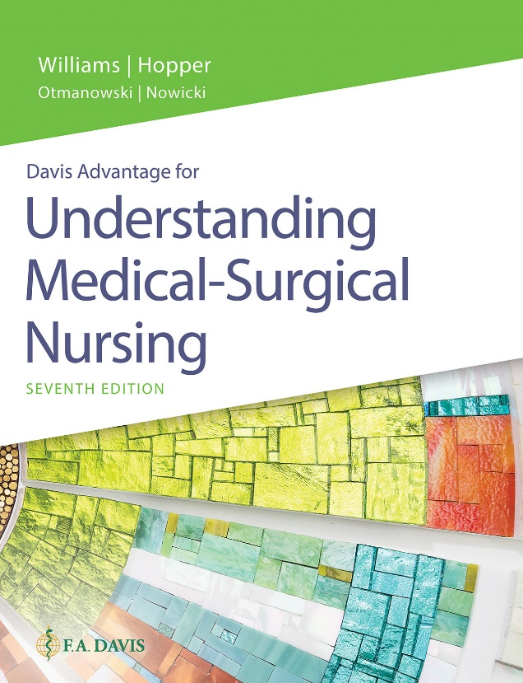
Book cover for Understanding Medical-Surgical Nursing, Seventh Edition.
Chapter 30
Nursing Care of Patients With Upper Respiratory Tract Disorders

Slide 2
Learning Outcomes
Explain the pathophysiology of disorders of the upper respiratory tract.
Describe etiologies and signs and symptoms of disorders of the upper respiratory tract.
Describe current therapeutic measures for disorders of the upper respiratory tract.

Slide 3
Learning Outcomes (continued)
Assist in planning nursing care for the patient with an upper respiratory disorder.
Discuss how you will know if your care has been effective.
Identify the special needs of the patient who has undergone a laryngectomy.

Slide 4
Epistaxis
More commonly known as a nosebleed
Causes
Dry, cracked mucous membranes
Trauma
Hypertension
Hemophilia
Medications

Slide 5
Epistaxis (continued)
Therapeutic interventions
Positioning
Direct pressure
Ice
Nasal packing
Nasal balloon catheter
Vasoconstrictive agent
Electrocautery

Slide 6
Nasal Polyps
Usually benign
Occur more often with allergies
Therapeutic interventions
Control allergies
Surgery
Avoid aspirin post-op.

Slide 7
Deviated Septum
Symptoms
Stuffy nose
Blocked sinus drainage
Headaches

Slide 8
Deviated Septum (continued)
Therapeutic intervention
Nasoseptoplasty
Monitor vital signs/bleeding.
Report excess swallowing.
Monitor dressing.
Teach post-op care: Avoid activities that increase pressure; avoid aspirin.

Slide 9
Sinusitis
Inflammation of sinus mucosa
Bacterial
Allergic
Signs and symptoms
Pain over affected sinus
Fever
Nasal discharge

Slide 10
Sinusitis (continued)
Therapeutic interventions
Saline irrigation
Intranasal corticosteroids
Decongestants
Hot packs
Acetaminophen/ibuprofen
Humidification
Oral fluids
Positioning
Antibiotics
Surgical drainage

Slide 11
Obstructive Sleep Apnea
Apnea during sleep
Risk factors
Obesity
High palate
Receded mandible
Smoking

Slide 12
Obstructive Sleep Apnea (continued_1)
Complications
Heart disease
Hypertension
Stroke
Diabetes
Signs and symptoms
Snoring
Daytime sleepiness
Headache
Memory and attention problems

Slide 13
Obstructive Sleep Apnea (continued_2)
Diagnostic test
Nocturnal polysomnography
Treatment
Avoid sedatives.
Lose weight.
Nasal patch
Continuous positive airway pressure (CPAP)
Surgery

Slide 14
Infectious Disorders
Viral rhinitis
Another name for common cold
Pharyngitis
Inflammation of the pharynx
Caused by beta-hemolytic streptococci, commonly referred to as strep throat
Laryngitis
Inflammation of mucous membrane of the larynx
Tonsillitis
Infection of tonsils

Slide 15
Influenza
Commonly called the flu
Transmitted by coughing and sneezing
Prevention
Yearly vaccination
Hand washing
Avoidance of infected people

Slide 16
Influenza (continued)
Signs and symptoms
Fever
Chills
Myalgia
Sore throat
Cough
Malaise
Headache
Therapeutic interventions
Acetaminophen
Avoid aspirin
Antiviral agents
Rest
Fluids

Slide 17
Other Respiratory Viruses
West Nile
Transmitted by mosquitoes
COVID-19
Avian influenza (bird flu)
Severe acute respiratory syndrome (SARS)
Swine flu (H1N1)

Slide 18
Nursing Diagnoses for Upper Respiratory Infections
Impaired Comfort
Hyperthermia
Risk for Infection (transmission to others)

Slide 19
Cancer of the Larynx
Pathophysiology
Primary tumor of mucosal epithelium
Metastasizes to lungs, liver, lymph nodes
Etiology
Associated with smoking, alcohol
More common in men

Slide 20
Cancer of the Larynx (continued_1)
Signs and symptoms
Hoarseness
Change in voice
Pain
Dyspnea
Cough
Dysphagia
Airway obstruction

Slide 21
Cancer of the Larynx (continued_2)
Diagnostic tests
Laryngoscopy
Computed tomography (CT) scan
Magnetic resonance imaging (MRI)

Slide 22
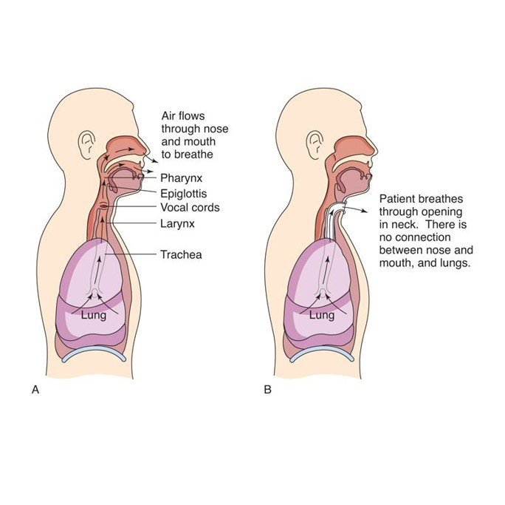
Cancer of the Larynx (continued_3)
Therapeutic interventions
Radiation
Chemotherapy
Laryngectomy
Before laryngectomy
After laryngectomy

Slide 23
Cancer of the Larynx (continued_4)
Postoperative nursing diagnoses
Ineffective Airway Clearance
Acute Pain
Impaired Verbal Communication
Imbalanced Nutrition
Impaired Swallowing
Grieving
Disturbed Body Image

Slide 24
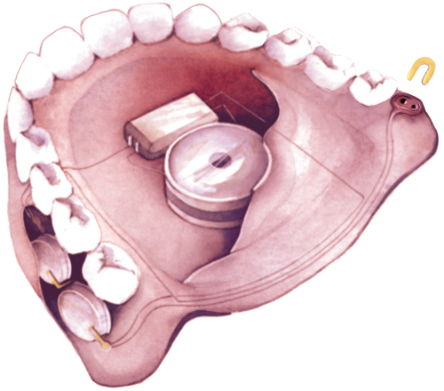
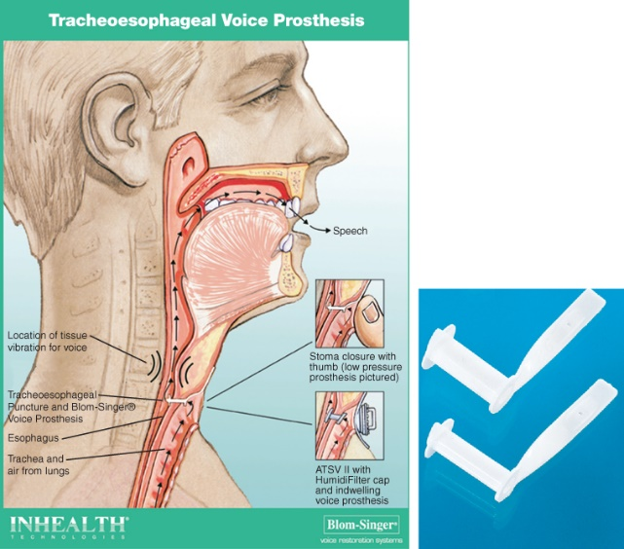
Devices to Aid Speech
UltraVoice is an electronic device placed inside a denture or retainer; the patient speaks into a small microphone.
The Blom-Singer voice prosthesis diverts air into the esophagus and out the mouth to form tracheo- esophageal speech.

Slide 25
Review Question #1
Ice packs are used for epistaxis for which reason?
To promote comfort
To promote vasoconstriction
To reduce swelling
To reduce congestion

Slide 26
Review Question #1 Answer
Correct Answer: 2

Slide 27
Review Question #2
What nursing instructions should be provided following septoplasty? Select all that apply.
Maintain semi-Fowler position.
Take stool softeners as prescribed.
Use ice for swelling.
Blow nose gently to remove clots.
Expect a low-grade fever for 3 days.

Slide 28
Review Question #2 Answer
Correct Answer: 1, 2, 3

Slide 29
Review Question #3
Which nursing intervention is appropriate for a sore throat?
Warm, moist pack
Hot tea
Bedrest
Saltwater gargle

Slide 30
Review Question #3 Answer
Correct Answer: 4

Slide 31
Review Question #4
Which patient is most at risk for complications of influenza?
46-year-old teacher
19-year-old student
78-year-old retiree
32-year-old factory worker

Slide 32
Review Question #4 Answer
Correct Answer: 3

Slide 33
Review Question #5
What are common risk factors for laryngeal cancer? Select all that apply.
Female
Smoker
Obesity
Alcohol abuse
Diet low in fruits and vegetables

Slide 34
Review Question #5 Answer
Correct Answer: 2, 4, 5

